Slide 1
End of Semester Presentation – Spring’13
Upsham Dawra, Sindhu Satish

Slide 2
Agenda
Project Overview
Team and stakeholders
Context
Project Status
Where we are – Tasks Completed
How we know – Process Followed
Road Ahead
QA

Slide 3
Team
Intro
Where we are
How we know
Future Steps
Sindhu Satish
Bachelors in Computer Science And Engineering
Interested in learning how to effectively transform Business goals into technical requirements through structured techniques
Upsham Dawra
Computer Engineering, Purdue University 2012
Interested in formal logic, operating systems and machine learning

Slide 4
Stakeholders
Intro
Where we are
How we know
Future Steps
Clients
David Garlan
Bradley Schmerl
Researchers with vision of extendable system allowing task composition by remote educators
Mentor – Daniel Plakosh
Robotics Group
Manuela Veloso
Interested in novel use of the Cobot3

Slide 5
What is Gizmo?
Intro
Where we are
How we know
Future Steps
Gizmo is a system developed for a tele-presence Robot called CoBot3
Attend classes virtually
Navigate workspace naturally
Be contextually aware
Use it from anywhere (web interface)
Variety of sensors
Kinect
Motors
Camera

Slide 6
Project Context
Intro
Where we are
How we know
Future Steps
A previous MSE team has developed software for the CoBot3
The system was meant to be used by educators to compose and execute high-level tasks with the robot
Eg. “Find Jane”, “Attend Poster session”
The system is unable to fulfill the goal of providing an easy way to execute high-level tasks
Our project goal is to
Allow users to compose tasks in an easy manner
Provide developers a way to add or delete code to utilize new hardware on CoBot

Slide 7
Where We Are…

Slide 8
Our Strategy
Intro
Where we are
How we know
Future Steps
We knew the main goal of the Spring semester is to gain requirements for the project
Because we inherited the previous code base which we were supposed to build upon, we did not immediately start typical requirements elicitation
We had to understand the code, perform extensive feasibility study and code analysis to nail down what can be used from the existing system and what is missing
We had to perform some preliminary set of tasks that were highly dependent on the outcome of the previous tasks

Slide 9
Project Status Trail
Intro
Where we are
How we know
Future Steps
Feasibility and System Analysis
Typical SE Activities
Making Gizmo System Work
Understand
Gizmo System
Task System Analysis
EOSP
Project Start
jBPM Feasibility Study
Capability Development
Fix Capability Integration Issues
System Redesign

Slide 10
Making Gizmo System Work
Intro
Where we are
How we know
Future Steps
Making Gizmo System Work
Project Start
Deployed the Gizmo System on CoBot
Made changes to code to make the Gizmo system work to a point that even the previous MSE team could not
Important to know current state of the system to establish our project goals
What is working?
What is not working?
What needs to be done, in addition, to the current status of the system to achieve clients’ vision?
Does it meet clients’ expectations?
EOSP

Slide 11
jBPM Feasibility Study
Intro
Where we are
How we know
Future Steps
jBPM Feasibility Study
Project Start
One of the previous team member suggested that jBPM and BPEL could be a good replacement to the Task Execution Language and Engine that they had built
Clients were interested in knowing how true is this
Ruled out fitment of jBPM as a replacement of the current Task Execution Engine in the Gizmo system
Research & Experimentation
Validation from subject matter experts
Very difficult task, given the time, resources and expertise
The Gizmo system as it looks is tightly coupled
EOSP

Slide 12
Understanding Gizmo System
Intro
Where we are
How we know
Future Steps
Understanding Gizmo System
Project Start
Client’s perception of system was different from ours
Understood the Gizmo system
Performed code walkthroughs and analysis & documented our understanding
Concluded that the system has issues in design and implementation
System is tightly coupled and deviates a lot from the design
Informed the Clients that a significant amount of effort will be required to fix it and that anything built on top of it will not be guaranteed to work
EOSP
Notes:
Talk about why system is “broken”

Slide 13
Capability Development
Intro
Where we are
How we know
Future Steps
Capability Development
Project Start
Clients now wanted to know how tightly coupled the system is and suggested that we try developing a proof-of-concept capability to evaluate the system
Developed a basic FindPhoto capability
Doesn’t use CoBot Hardware
Unit tested
Documented the steps taken to develop this capability
Also documented how these steps deviated from Gizmo Capability Development Guidelines
EOSP

Slide 14
Fix Capability Integration Issues
Intro
Where we are
How we know
Future Steps
Fix Integration Issues
Project Start
Clients wanted to see the degree of changes & challenges that we would face upon integration
We integrated the capability with the system & found several issues
Made it work to an extent that uncovered several flaws in the Gizmo system
Documented flaws & proved that the system is indeed tightly coupled & has deviations from the design
EOSP

Slide 15
Task System Analysis
Intro
Where we are
How we know
Future Steps
Task System Analysis
Project Start
Clients revealed that their main interest is on Task compose-ability and execution part of the system
Performed a thorough analysis of Task Composition & Execution work flow in the Gizmo system
Exposed missing gaps and aberrance in the protocol
Validated our findings with previous team member and found that we were right!
Apprised the Clients that their vision of Task System differed from what was implemented
EOSP

Slide 16
System Re-Design Strategy
Intro
Where we are
How we know
Future Steps
System Re-Design
Project Start
Clients understood that the system did not reflect their vision
Focus on Client’s notion of Capabilities/Tasks and their Composition & Execution
We wanted a more formal technique to validate our understanding of Clients’ notion of Tasks/Capabilities
Clients suggested we use Z Specification
Produced a preliminary Z Specification
Leveraged Client’s expertise on Z to specify and validate correctness
EOSP

Slide 17
System Architecture Design
Intro
Where we are
How we know
Future Steps
System Re-Design
Project Start
We started thinking of the system in-terms of Architectural Components & Connectors
We produced a preliminary Architecture for system by leveraging resources from ours as well as Architectures course
We walked the clients through the design
We clarified the design as suggested by the clients
EOSP
Notes:
After Z we started thinking about architecture May 27th Formal Review

Slide 18
Reflections
Intro
Where we are
How we know
Future Steps
Analysis of a complex code base with a number of defects can be frustrating, and may lead to improper conclusions
Produced results that led clients to re-think the project
Tried very hard to map our project to a standard Software Engineering project- Could not accept the fact that this was a research-based project
Documenting changes and new findings made on the inherited code base helps in revisiting for future reference

Slide 19
How We Know…

Slide 20
Process Evolution
Intro
Where we are
How we know
Future Steps
Scrum
Scrum + ACDM
Tailored Process
Kicked off with Scrum
Seemed like a good fit initially – 2 week sprints
No groundwork for exploration type work (what if ‘x_{t}’ is dependent on ‘x_{t-1}’?)
Moved to ACDM integrated with Scrum
Idea was that ACDM experiments could help drive JBPM experiments, etc.
Started running into full product backlog changes, and a lot of overhead in re-estimating over and over again
Finally decided to use a tailored process to fit our needs

Slide 21
Current Process - Overview
Intro
Where we are
How we know
Future Steps
Borrows heavily from Scrum
Instead of a consistent product backlog, negotiate next steps (and next week’s deliverable) every week
Clients could factor in new developments due to changes in underlying project assumptions
Short week-to-week cycle instead of longer periods
Use daily status meetings within the cycle
Highly risk-driven
Continually update risk list, act on risks, use them to drive client discussions
Use a high-level goal for semester as the end goal
“Be able to decide on what exactly is to be constructed over the summer, given current understanding of Gizmo system”
“Be able to plan summer work and settle on a ‘success criterion’ for the project, given that the Gizmo assumptions do not hold”

Slide 22
Current Process – How?
Intro
Where we are
How we know
Future Steps
Breakdown the deliverable into tasks, and estimate right after client meeting
Assign tasks, track progress
Daily progress meetings within team
Formal standup -> Status Email -> Status over phone
If not on track or facing issues, inform clients beforehand
Open channel of communication over email
Meet day-before-meeting, finalize deliverable, spend some time on process
Set expectations for meeting beforehand over email
15-minute open time to talk about current cycle and suggestions
Update risk list together, see what’s ‘bubbling up’

Slide 23
Process - Did we improve?
Intro
Where we are
How we know
Future Steps
We saw a definite improvement
Time estimations were much better due to week by week estimation
Able to deliver every week without fail, new avenues on a weekly basis
We were able to reduce our overhead
Take advantage of two-person team by doing all the Scrum data collection, but in a more tailored fashion
Risks got high importance, and we overcame seemingly impossible issues
After proving that the Gizmo system may not be what the client is looking for, we had burnt through time and were only entering usual requirement elicitation
Were able to efficiently settle on a set of requirements, utilize Architecture and Analysis course to come with something that was satisfactory for clients

Slide 24
Overall Planned vs Actual Effort
Intro
Where we are
How we know
Future Steps
+27.7%

Slide 25
New Process Planned vs Actual
Intro
Where we are
How we know
Future Steps
+2.2%

Slide 26
Earned Value Chart
Intro
Where we are
How we know
Future Steps
Value Earned (%)
Time (Weeks)

Slide 27
Top 3 Current Risks
Intro
Where we are
How we know
Future Steps
Risk Condition | Risk Consequence | Risk Strategy | Mitigation Plan
The team may fall-short of resources (time) to fully implement (develop) task execution and composition part of the system | Client may expect the team to deliver fully implemented system and may be dissatisfied | Mitigate | Estimate and communicate with clients before hand and make them sign off the SOW
The team may not be able to conceive client's notions of tasks and capabilities through typical requirements engineering techniques | The team may end up with incomplete and fallacious requirements, leading to a system that was not what the clients expected | Mitigate | Employ formal specification of requirements (use Z specification, formal modeling etc) and get constant feedback from clients
Clients more interested in findings rather than a final working product | The team may end up doing more research work than developing software. Also, MSE mentors and professors might not approve. | Mitigate | Estimate and plan experimentation tasks as project tasks. Document details of experimentation. Document fixes made to the code base.

Slide 28
Risk Analysis
Intro
Where we are
How we know
Future Steps
Risks
Technology
Requirements
Scope
Resources
Sources of Risks
Risks that turned into problems = 1
Time spent on Risk Management = 3%
1 Open
5 Monitor
17 Total
11 Closed

Slide 29
Issues being faced with Process
Intro
Where we are
How we know
Future Steps
Mercenaries-for-hire mentality can make it easy to lose sight on the end goal
Writing down a concrete end goal helps
Risk strategy can help with this
Very little planning for anything apart from ‘happy path’
What if ‘x’ assumption does not hold?
Work done included a lot of research into various avenues
Process seems to do well here, but what about estimating repeated tasks (for example, cycles in development)?

Slide 30
Reflections
Intro
Where we are
How we know
Future Steps
When the interest is in exploring the solution space instead of a cohesive end product, a traditional SE process may not be appropriate
A tailored process can vastly improve accuracy of estimates
Client involvement and a continuous feedback loop helps greatly
Working week-to-week means that Earned Value may not be a good indicator of final deliverable

Slide 31
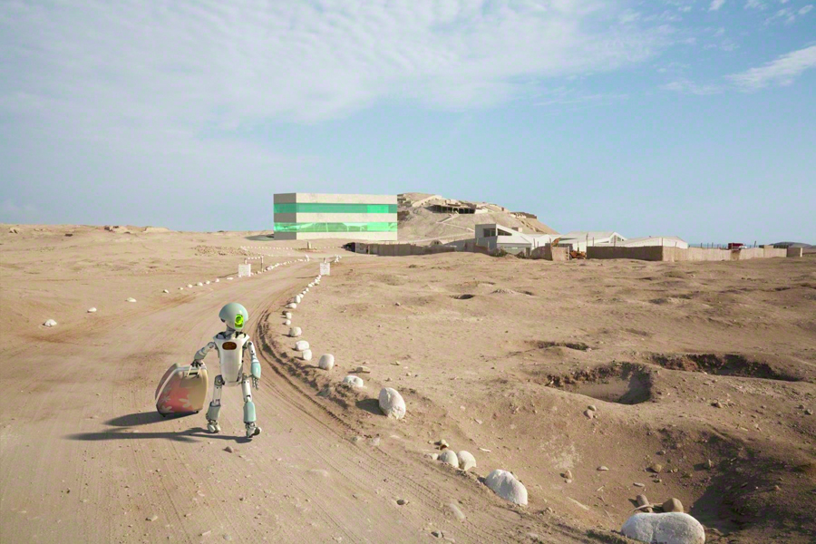
Road Ahead…

Slide 32
Summer Work - Estimation
Intro
Where we are
How we know
Future Steps
Time (Man-hours)
Notes:
GizmoE = 576, Gizmo = 3840

Slide 33
Summer Work - Estimation
Intro
Where we are
How we know
Future Steps
Time (Man-hours)
Notes:
GizmoE = 576, Gizmo = 2880

Slide 34
Summer Work - Estimation
Intro
Where we are
How we know
Future Steps
Time (Man-hours)
Notes:
GizmoE = 576, Gizmo = 960

Slide 35
Summer Work
Intro
Where we are
How we know
Future Steps
Communicated resource-crunch to client
Client agreed to renegotiate exact deliverable based on the architecture
Deliver a scaled-down version of the system
First, formal review of architecture by clients
Finalize on formal Z specification
Have created a milestone plan
May need to revamp our process to better suit developmental activities
Notes:
Have already communicated to the client that we cannot deliver a full tasking system based on resources available
Client agreed to renegotiate what we will deliver based on the architecture
Looking to deliver a scaled-down version of the system
First, would like a formal review of architecture by clients
Also, finalize on formal Z specification to make sure that team’s understanding of tasks/capabilities aligns with client sensibilities
Have created a temporary milestone plan
May need to switch processes to better suit developmental activities

Slide 36
Milestone Plan
Intro
Where we are
How we know
Future Steps
27th May
3rd June
Architecture Accepted
Formal Architecture Review
10th June
Acceptance of Z Spec
First Release
8th July
22nd July
Third Release
29th July
Transition Documents Review
5th August
Final Walkthrough
Second Release
24th June

Slide 37
Questions?

Slide 38
Backup

Slide 39
Index of Backup
Earned Value – 40
Risk – 42
jBPM – 46
Capability Development – 48
Spike, Spring Break Work – 49
Understanding Gizmo Task System – 51
Problems with Old Code – 53
Z spec – 52
Difference in design – 54
Architecture
Drivers and Views – 56
Runthrough – 59
Decisions and business mapping – 70
Quality Plan – 78
Tools – 80
Context Diagram - 81
Go Back to Index - 39

Slide 40
Flattened Earned Value Chart

Slide 41
Earned Value Chart - Analysis
Estimated week-to-week, and each week’s work was almost fully dependent on previous week
Each week, delivered fully on what was promised last week
Thus, planned value and earned value overlapped
In Scrum and Scrum+ACDM, thought that architecture was main goal of this semester
No such formal requirement from MSE or Clients AFAIK
Did not consider value added by feasibility and verification of previous system
Led to erroneous chart
Can plot a chart using finalized architecture as end goal, along with knowing exactly what we will deliver
Erroneous assumption, because of high dependency in stages

Slide 42
Old Earned Value Chart
-15%

Slide 43
Risks – What all is included
ID
Current Status
Risk Impact
Probability
Timeframe
Priority
Risk Condition
Risk Consequence
Risk Strategy
Mitigation Plan
Category
Reason for closing
Action Item

Slide 44
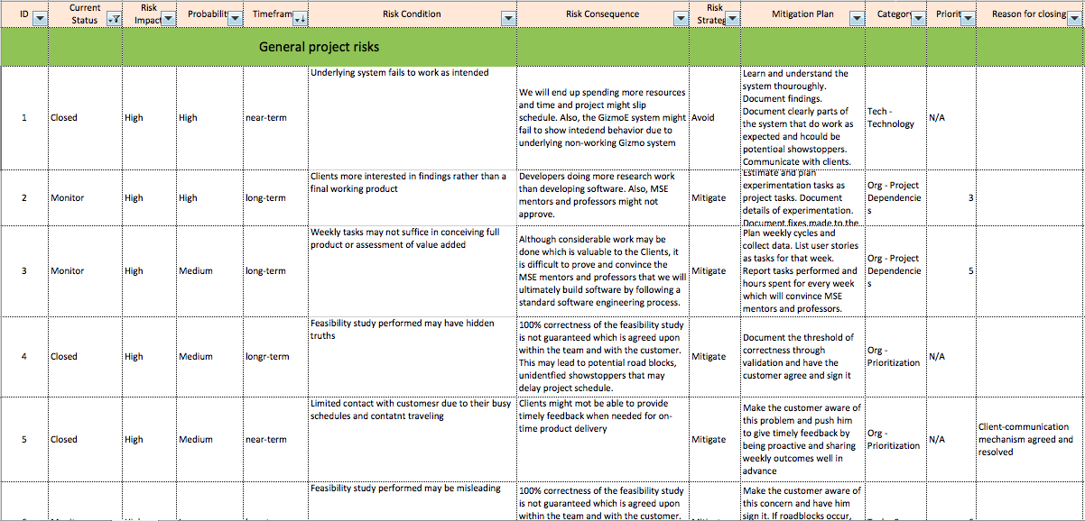
Risk Snapshot

Slide 45
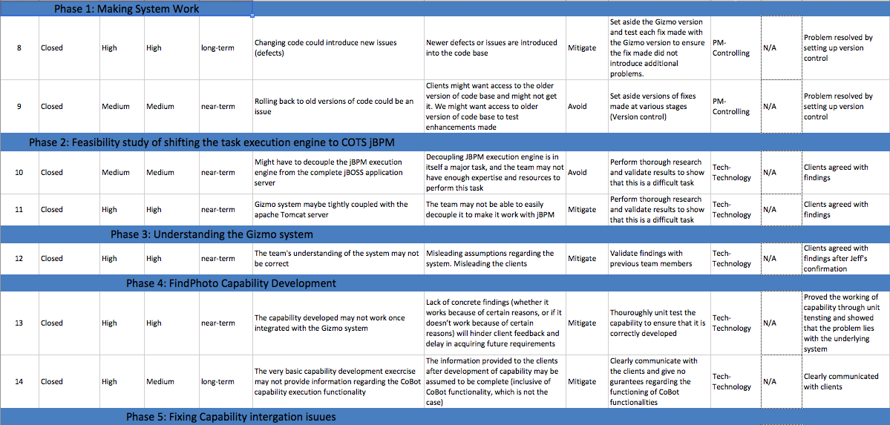
Risk Snapshot 2

Slide 46
jBPM Feasibility Study 1
jBPM is a business process execution engine present in JBoss Application server
Focused for web-services, although, it can be used for direct class invocation within a Gizmo like web application too
Use the jBPM modeler to create a Business Process
Specify the classes to be called for each node.
Export the process definition file
jBPM will be initialized as a process in Jboss
All classes will be executed as per the workflow. One can specify ANDs/ORs/XORs etc. in the workflow as decision nodes.
This will be done till the END node is hit. There can be multiple END nodes

Slide 47
jBPM Feasibility Study 2
Potential show-stoppers in shifting to jBPM
jBPM doesn’t support parallel tasks, while Clients are interested in parallelism
jPDL doesn’t supporting forking, while the Client’s notion of task composition & execution involves forking [ref]
Tight integration of the Gizmo Execution engine and all components interacting with it could lead to multiple issues in integrating jBPM
There could be/will be multiple thread-safety issues in jBPM. There are multiple assumptions about threads and data between them in the current Gizmo System. In jBPM, these may not hold, leading to major logic changes in the Gizmo System
The current system is on Tomcat. Shifting to jBPM would require shifting to JBoss Application Server. This will impose overhead and could require a lot of time
http://stackoverflow.com/questions/2044926/true-parallel-processing-in-jbpm - ref

Slide 48
Capability Development
Unit test results

Slide 49
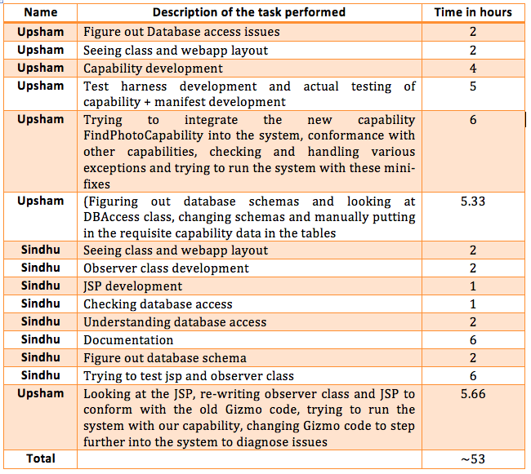
Capability Development - Spike
Task & Time breakdown

Slide 50
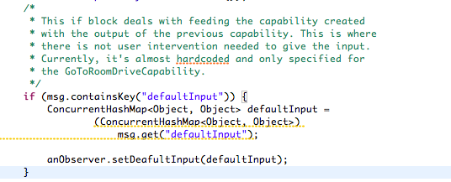
Understanding Task System
Leveraged the knowledge and understanding of other teams analyzing the Gizmo task execution protocol in the Analysis Class
Used Model Checking- Promela, jSpin
Proved that there are discrepancies in the system by highlighting code blocks in documentation

Slide 51
Some Problems with Old Code
Partial and inconsistent implementation of task input
Default input used erratically
It seems to be used as sidecar to get input to capabilities
Many hidden assumptions
Undocumented “oh-by-the-way”s
Abundant use of java reflections and exact method name/type checking, leading very brittle code that is very finicky even about naming conventions within the code
Partial implementation of other (as yet untouched by GizmoE) features, which may or may not introduce further assumptions
TaskReservation
Pausable capabilities
Parallel capabilities are parsed and ‘composed’. Current implementation does not support them
System design had no ‘wait’ for all parallel executions to finish

Slide 52
Z Specification
Focus on concept of task and capability
What is a task?
What is a capability?
Special focus on Task I/O
Sequential
Parallel
New Specification has task ‘re-composability’
Task within a task
I/O are ‘collected’ at the beginning and at the end of each task
Connectors include a ‘mux’-like selector, which can either take input from collection or from user
Does not specify error handling still (can have a standard ‘error’ capability plugged always in parallel, or a new default connector like stderr in linux)

Slide 53
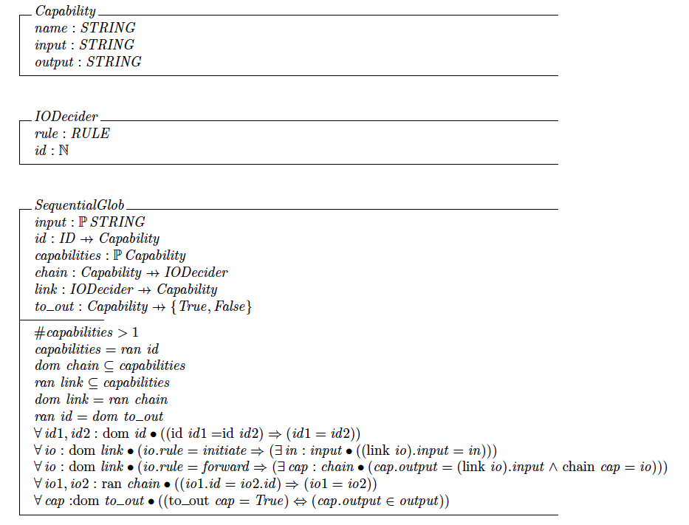
Z Specification - Snapshot

Slide 54
What’s different in our design?
Judicious use of the event bus
Previous design had events going from front-end (task-client) all the way to capability
We converted frontend to all call-return, and used events only to manage capability execution
Well defined I/O from capabilities
Responsibility for handling I/O is clearly stated, and has dedicated components in design
An MVC is implemented along with task execution to get user input
Design-level splitting of task composition and execution
Gizmo team did this while implementing, and design was not focused
Notes:
Architecture

Slide 55
What’s different in our design?
Checking of tasks and capabilities at composition
Static analysis (type-checking) along with plug-and-play analysis blocks for Q-learning type analyses
Task recomposability
A user can create a task within a task, to get a meaningful ‘vocabulary’
Enhances what you can do with the system with only a few capabilities
Notes:
Architecture

Slide 56
Architectural Drivers
Functional requirements
Sequential and Parallel task execution, with correct I/O
‘Meaningful’ task composition (Type-checking)
Interruptible tasks
Addition of capabilities possible by developer
Quality Attributes
Reliability – Error handling (Ability to inform the user in case of a failure)
Runtime Extensibility – Ability to add capabilities while system is running
Static reusability and extensibility – Code framework to easily add new capabilities to the system
Performance – Response time for composition and execution should not be unreasonable

Slide 57
Architecture – Dynamic View
Overall Architecture – Dynamic View

Slide 58
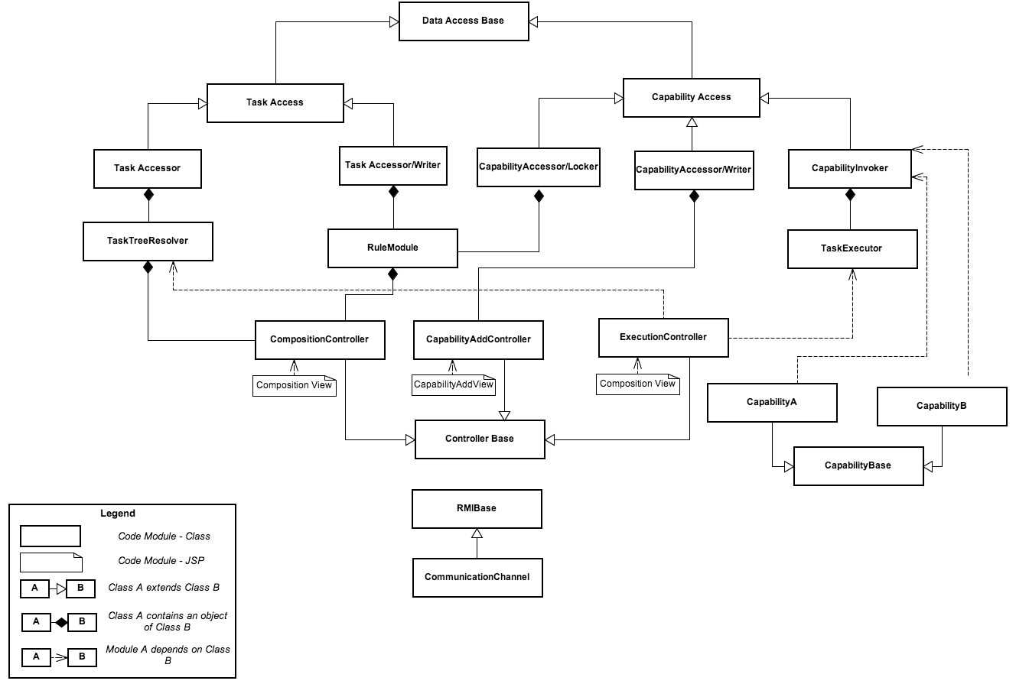
Architecture – Static View
Overall Architecture – Static View

Slide 59
Legend
Capability
Task
I/O to component
Task composed by user

Slide 60
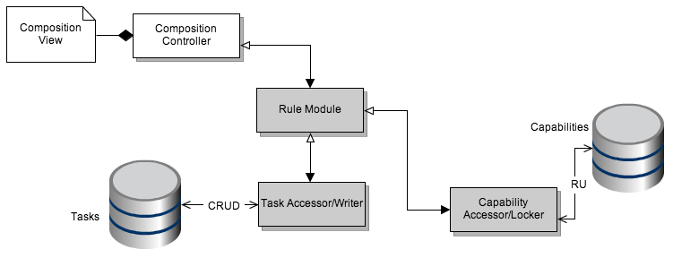
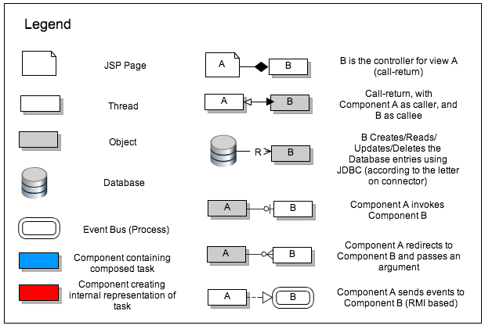

Slide 61
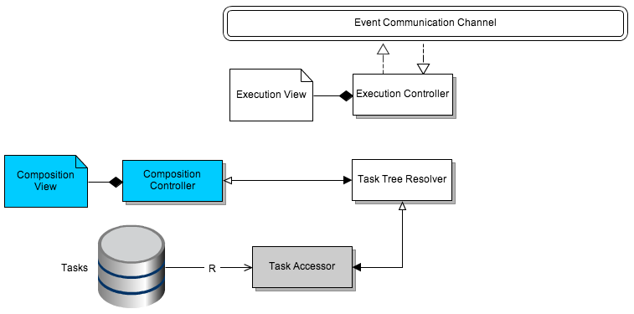

Slide 62
Legend
Executed Capability
Currently Executing
Capability
To Be Executed
Capability
Already Executed
I/O to capability
Currently Executing
I/O to capability
To Be Executed
I/O to capability
Overall Input
Task resolved by system
Overall Output

Slide 63
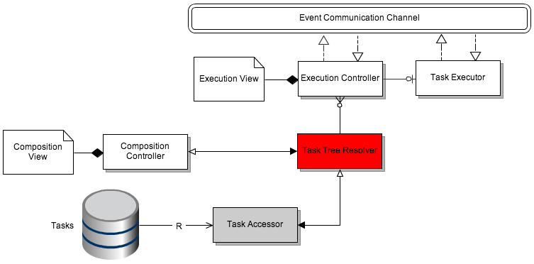
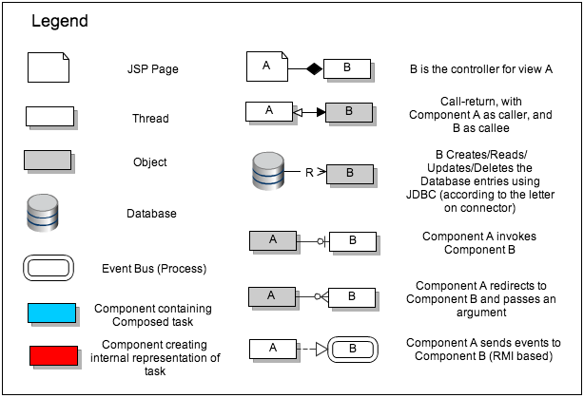

Slide 64
Legend
Executed Capability
Currently Executing
Capability
To Be Executed
Capability
Already Executed
I/O to capability
Currently Executing
I/O to capability
To Be Executed
I/O to capability
Overall Input
Sequential Execution
Overall Output

Slide 65
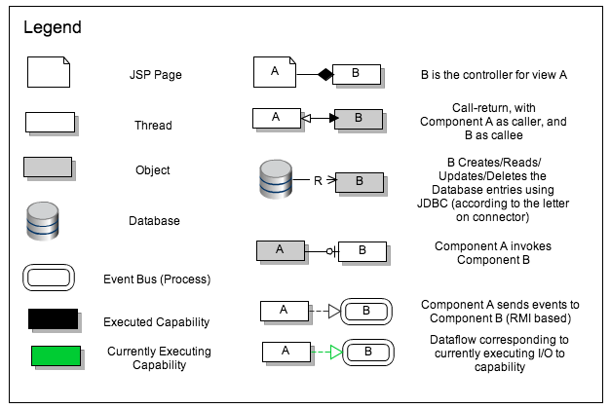

Slide 66
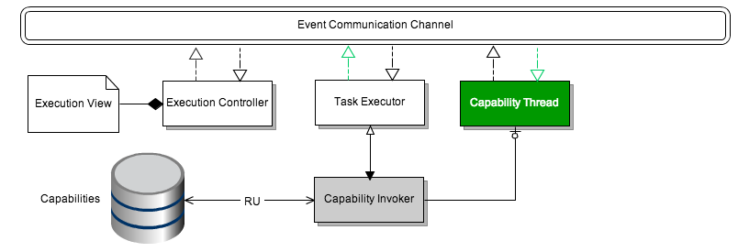

Slide 67
Legend
Executed Capability
Currently Executing
Capability
To Be Executed
Capability
Already Executed
I/O to capability
Currently Executing
I/O to capability
To Be Executed
I/O to capability
Overall Input
Parallel Execution
Overall Output

Slide 68
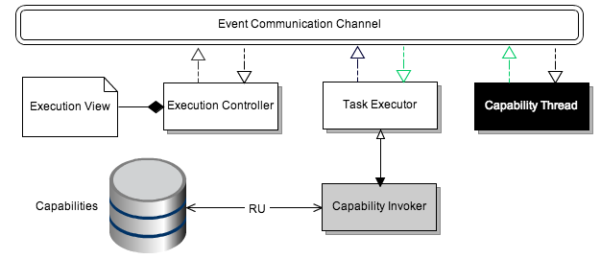

Slide 70
Major Architectural Decisions
Event-based communication
Affects performance and reliability negatively, but promotes interruptability and parallel/sequential task I/O
Flatten the DAG before execution
Improves performance, but loses task context
Use of thread pool
Central location for creating threads, assigning IDs. Improves performance

Slide 71
Major Architectural Decisions Contd.
Singular Task Executor
Decouples user view (separate controller for it) and can manage tasks. Promotes sequential/parallel tasks and I/O, error-reporting as well as interruptibility.
Separate priority queues
To promote interruptibility and reliability(error-handling), but decreases performance due to more polling required
Heartbeat mechanism
To increase reliability of capabilities (error-reporting). This decreases performance

Slide 72
Mapping to business goals
Business Goals
Decisions
Event Based Communication
Flatten the DAG
Thread Pool
Singular Task Executor
Separate priority queues
Heartbeat mechanism
Variety of tasks with I/O
Interrupt a task
Inform user about error
Allow capability addition
Not frustrating (performance)

Slide 73
Mapping to business goals
Business Goals
Decisions
Event Based Communication
Flatten the DAG
Thread Pool
Singular Task Executor
Separate priority queues
Heartbeat mechanism
Variety of tasks with I/O
Interrupt a task
Inform user about error
Allow capability addition
Not frustrating (performance)

Slide 74
Mapping to business goals
Business Goals
Decisions
Event Based Communication
Flatten the DAG
Thread Pool
Singular Task Executor
Separate priority queues
Heartbeat mechanism
Variety of tasks with I/O
Interrupt a task
Inform user about error
Allow capability addition
Not frustrating (performance)

Slide 75
Mapping to business goals
Business Goals
Decisions
Event Based Communication
Flatten the DAG
Thread Pool
Singular Task Executor
Separate priority queues
Heartbeat mechanism
Variety of tasks with I/O
Interrupt a task
Inform user about error
Allow capability addition
Not frustrating (performance)

Slide 76
Mapping to business goals
Business Goals
Decisions
Event Based Communication
Flatten the DAG
Thread Pool
Singular Task Executor
Separate priority queues
Heartbeat mechanism
Variety of tasks with I/O
Interrupt a task
Inform user about error
Allow capability addition
Not frustrating (performance)

Slide 77
Mapping to business goals
Business Goals
Decisions
Event Based Communication
Flatten the DAG
Thread Pool
Singular Task Executor
Separate priority queues
Heartbeat mechanism
Variety of tasks with I/O
Interrupt a task
Inform user about error
Allow capability addition
Not frustrating (performance)

Slide 78
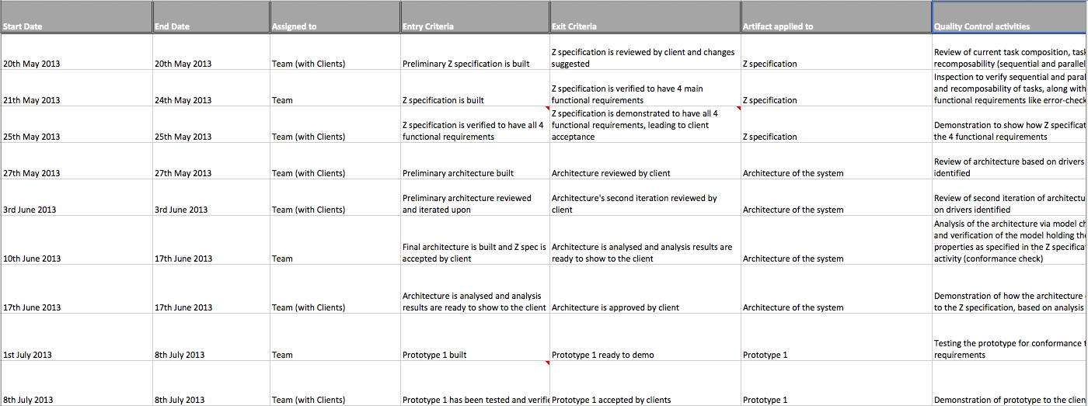
Quality Plan Snapshot

Slide 79
Quality Plan
Answers all 10 quality questions
Quality Activities
Artifacts applied to
When is it done? Who does it?
Entry and exit criteria
Drawn according to milestone plan
Has not been updated with the new milestone plan
Estimates that we will spend around 42% of our time in quality activities in summer
May not have enough time to dedicate
Need to re-work on quality plan

Slide 80
Tools
Process/Project Management
Source Control
Development Environment

Slide 81
Context Diagram
Executes Tasks
Adds Capability corresponding to
hardware additions
Composes Tasks
Naïve user
Uses CoBot hardware
to execute task
Developer
Adds Hardware to Cobot

